Slide 1

DATABASE MANAGEMENT SYSTEM PROJECT
Library Management
with RFID Integration
BATCH:20
TEAM MEMBERS:
C.V.JASWANTH REDDY - 2520080025
B.SIDDHARTHA - 2500090225
SANTOSH- 2520090051
Review-2

Slide 2

02
Introduction
  Library Management System with RFID Integration is a web-based system designed to automate and simplify traditional library operations.
  The system uses RFID technology to identify books and automate book issue and return processes.
  It provides centralized management of books, members, transactions, fines, and inventory.
  The system is developed using React.js, Node.js, Express.js, MySQL, and RFID Reader API.
  It aims to reduce manual work, improve accuracy, save time, and provide efficient library management.
SCAN
SYNC
TRACK
RFID × DBMS / LIBRARY MANAGEMENT

Slide 3

03
problem Statement
  Traditional library operations involve manual book issue and return processes.
  Manual handling can lead to long waiting times and increased workload for library staff.
  Maintaining book inventory and transaction records manually can be difficult.
  Fine calculation and dues management require additional manual effort.
  Tracking the movement and availability of books efficiently can be challenging.
  Therefore, there is a need for an automated RFID-based system to improve the speed, accuracy, and efficiency of library operations.
RFID × DBMS / LIBRARY MANAGEMENT

Slide 4

04
Main Objectives
  To automate book issue and return operations using RFID technology.
  To maintain centralized records of books, members, and transactions.
  To provide real-time book inventory tracking and stock verification.
  To automate fine and dues calculation for overdue books.
  To reduce manual work and waiting time for library staff and users.
  To improve library security through RFID-based book monitoring.
  To generate reports for efficient library management.
RFID × DBMS / LIBRARY MANAGEMENT

Slide 5
05
RFID-Based Proposed System
  A web-based library management system integrated with RFID technology.
  RFID tags are assigned to books for quick and automatic identification.
  Automates book issue and return operations using RFID scanning.
  Maintains centralized records of books, members, and transactions.
  Provides automated fine and dues management.
  Supports stock verification, book recommendations, and report generation.
  Reduces manual work and improves the speed, accuracy, and efficiency of library operations
Traditional System → Manual Process → More Time
Proposed System → RFID Automation → Faster & Efficient
DATABASE
Persists every event
RFID × DBMS / LIBRARY MANAGEMENT

Slide 6
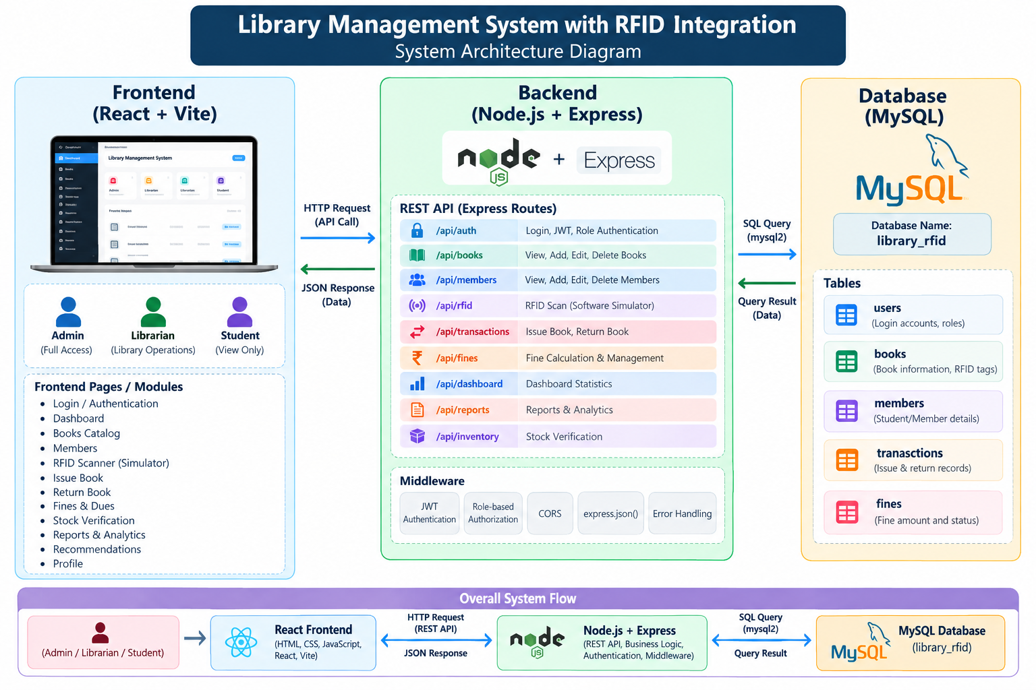
System Architecture
06

Slide 7
08
System Modules
  Catalog & RFID Tagging – Manage books and assign unique RFID tags for identification.
  Issue/Return Automation – Automate book issue and return using RFID scanning.
  Fine & Dues Management – Calculate and manage fines for overdue books.
  Member Management – Maintain and manage library member information.
  Book Recommendations – Provide recommendations based on available library titles.
  Stock Verification – Track book availability and verify library inventory.
  Reports – Generate reports related to books, members, transactions, fines, and stock.
STUDENT
RFID_TAG
FINE
One student → many transactions / One book → many transactions over time / Librarian manages circulation
RFID × DBMS / LIBRARY MANAGEMENT

Slide 8



09
RFID Workflow
1
Assign unique tag
2
Scan with reader
3
Retrieve RFID number
4
Query book record
5
Check availability
6
Record issue / return
RFID LIB00125
Database Management Systems
AVAILABLE
RFID × DBMS / LIBRARY MANAGEMENT

Slide 9


11
Advantages
01
02
03
04
FASTER
ACCURATE
REAL-TIME
LEANER
Issue and return
Automatic identification
Inventory availability
Less work, fewer errors
05
06
07
SAFER
CLEARER
CENTRAL
Fewer lost books
Instant reports
One shared database
RFID × DBMS / LIBRARY MANAGEMENT

Slide 10


07
Database Design
STUDENT
BOOK
Student_ID · Name · Department · Phone
Book_ID · Title · Author · ISBN · Category · RFID_Tag
AUTHOR
CATEGORY
Author_ID · Author_Name
Category_ID · Category_Name
ISSUE_RETURN
FINE
Transaction_ID · Book_ID · Student_ID · Issue_Date · Return_Date
Fine_ID · Transaction_ID · Amount · Status
LIBRARIAN
Librarian_ID · Name · Username · Password
RFID × DBMS / LIBRARY MANAGEMENT

Slide 11


10
SQL Operations
SELECT * FROM Books
WHERE Category = 'Database';
UPDATE Books SET Status = 'Issued'
WHERE Book_ID = 101;
SELECT * FROM Issue_Return
WHERE Return_Date IS NULL;
SELECT Student_ID, COUNT(*) AS Books_Issued
FROM Issue_Return GROUP BY Student_ID;
SELECT INSERT UPDATE DELETE JOIN GROUP BY
RFID × DBMS / LIBRARY MANAGEMENT

Slide 12
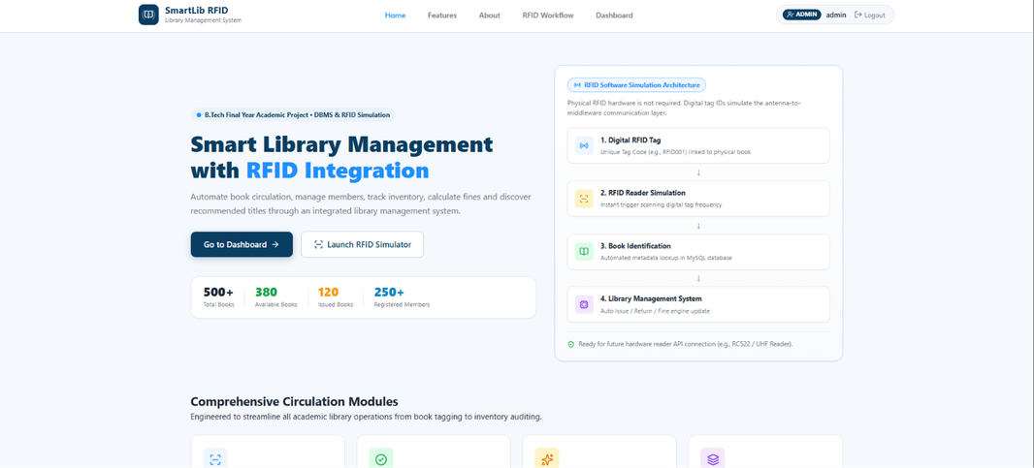
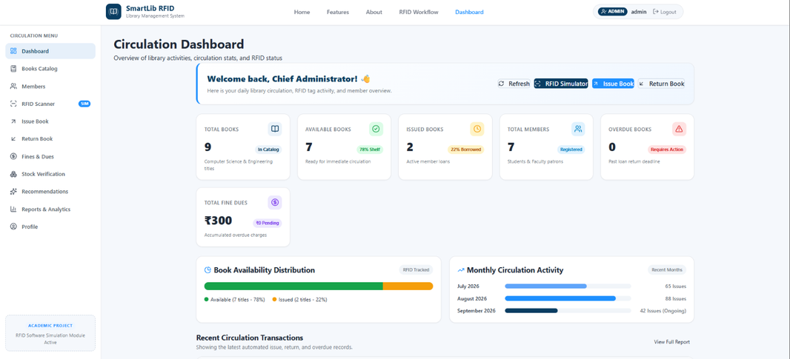
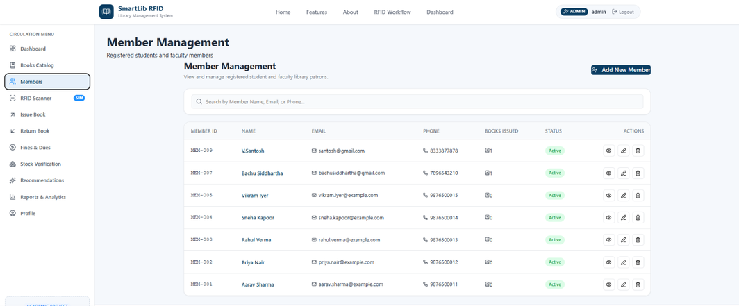
10
outcomes
SELECT * FROM Issue_Return
WHERE Return_Date IS NULL;
RFID × DBMS / LIBRARY MANAGEMENT

Slide 13

12
Future Scope & Conclusion
NEXT
RFID + DBMS turns circulation into a connected, automated service.
Mobile integration
Self-service RFID kiosks
Entry / exit tracking
Email & SMS alerts
Online reservations
Cloud database
AI recommendations
The system improves accuracy and efficiency, reduces manual effort, and creates one dependable view of books, members, and transactions.
RFID × DBMS / LIBRARY MANAGEMENT

